Slide 1
Substation and Distribution Automation
Module 4: Voltage Control Devices

Slide 2
Module 4 Overview
Part 1: Operational Voltage Control
Part 2: Voltage Regulators
Part 3: Shunt Capacitors
Part 4: Detailed End-use Load Models

Slide 3
Part 1: Operational Voltage Control
As current flows down a distribution line a voltage drop occurs because of the impedance.
The amount of voltage drop is a function of multiple factors:
Load level (current)
Construction of distribution line (impedance)
Operation of voltage control devices (if present)
Variations in voltage along a distribution line cannot be prevented, but they can be controlled.

Slide 4
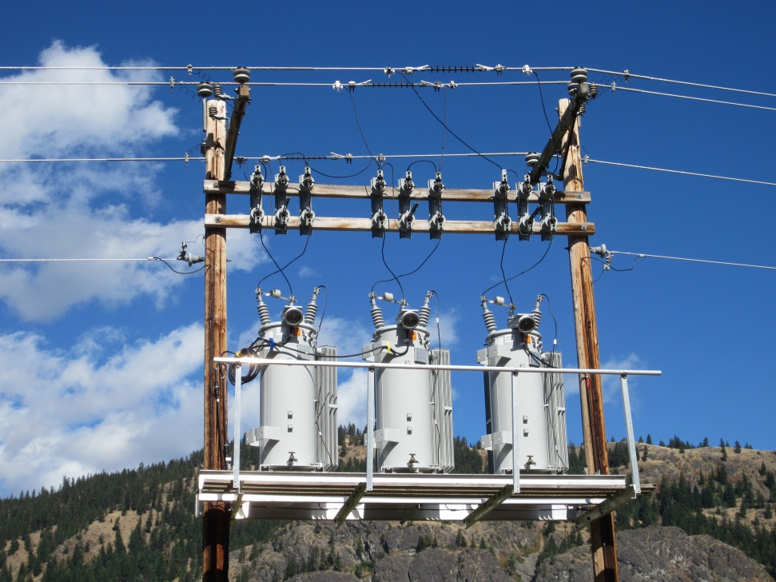
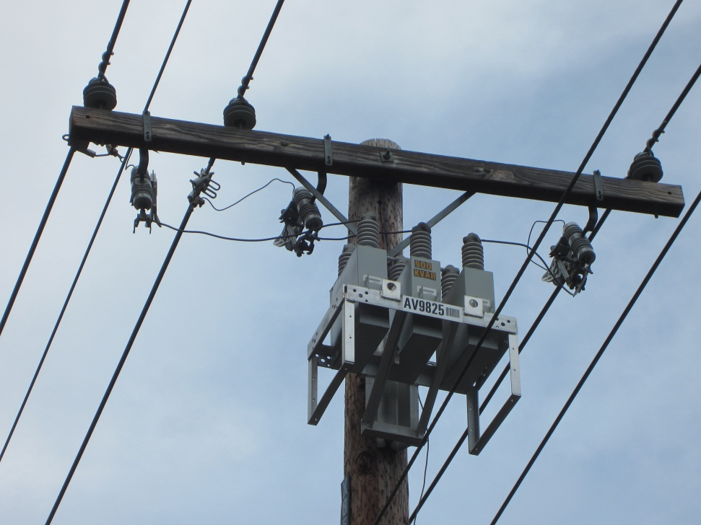
Traditional Voltage Control

Slide 5
ANCI C84.1
American National Standards Institute (ANSI) C84.1 standard defines operating limits for distribution systems.
The ANSI limits apply to the voltage at the point of delivery for the end-use customer.
Range A (normal steady-state):114V-126V (RMS)
Range B (emergency steady-state):107V-127V (RMS)
<3% voltage unbalance at the utility meter

Slide 6
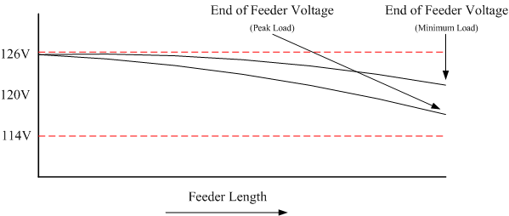
Operational Voltage Control
The voltage supplied to the customer is generally maintained within the limits set by ANSI C84.1.
This is done by setting the voltage at the “head” of the feeder at the high end of the band, to ensure that the voltage drop at peak load does not exceed limits.
The voltages shown in the figure below are the voltages seen by the end-use customer.

Slide 7
Voltage Regulation
Voltage regulation is the ability of a system to provide a nearly constant voltage over varying load conditions.
Voltage regulation is a unit less value that is measure of the voltage variation between no load and full load.
While distribution systems generally do not examine the no load condition, a measure between peak load and minimum load can be examined.
Example: an end-use customer is supplied 120V nominal, with the actual voltage being 117V at peak load, V_{peak}, and 122V at minimum load, V_{min}. Calculate the percent voltage regulation

Slide 8
Voltage Regulation Example
Because of the non-linear characteristics of the voltage drop on a distribution line, voltage regulation is not the same on all points of a distribution feeder.

Slide 9
Substation Voltage Regulators
Regulators are often installed at the substation in order to adjust the voltage at the head of the feeder. This can help to improve the voltage regulation.
The figure below shows a feeder at two different tap positions, one for peak load and one for minimum load.
A distribution feeder with improved voltage regulation can support more load, increasing the utilization of assets.

Slide 10
Downstream Voltage Regulators
In cases with heavy loading a single regulator at the substation is not able to maintain voltage along the entire length of the feeder.
One solution to this problem is the use of downstream voltage regulators.

Slide 11
Shunt Capacitors
If the feeder is heavily loaded then a shunt capacitor can be installed to reduce the reactive power flows, reducing the voltage drop.
By supplying the leading reactive power locally this reduces the reactive power needs of the feeder and allows for increased loads to be supported.

Slide 12
Phasor Diagram of Shunt Capacitors
Case 1: No capacitor
Case 2: With capacitor

Slide 13
Operation of Voltage Control Devices
Voltage control devices, both regulators and shunt capacitors, traditionally have been operated in a stand alone mode.
Stand alone operation is achieved through manual operation, local set points, and on occasion remote measurements.
While the set points may be coordinated, it is a static coordination and does not account for time dependant variations in the system behavior.

Slide 14
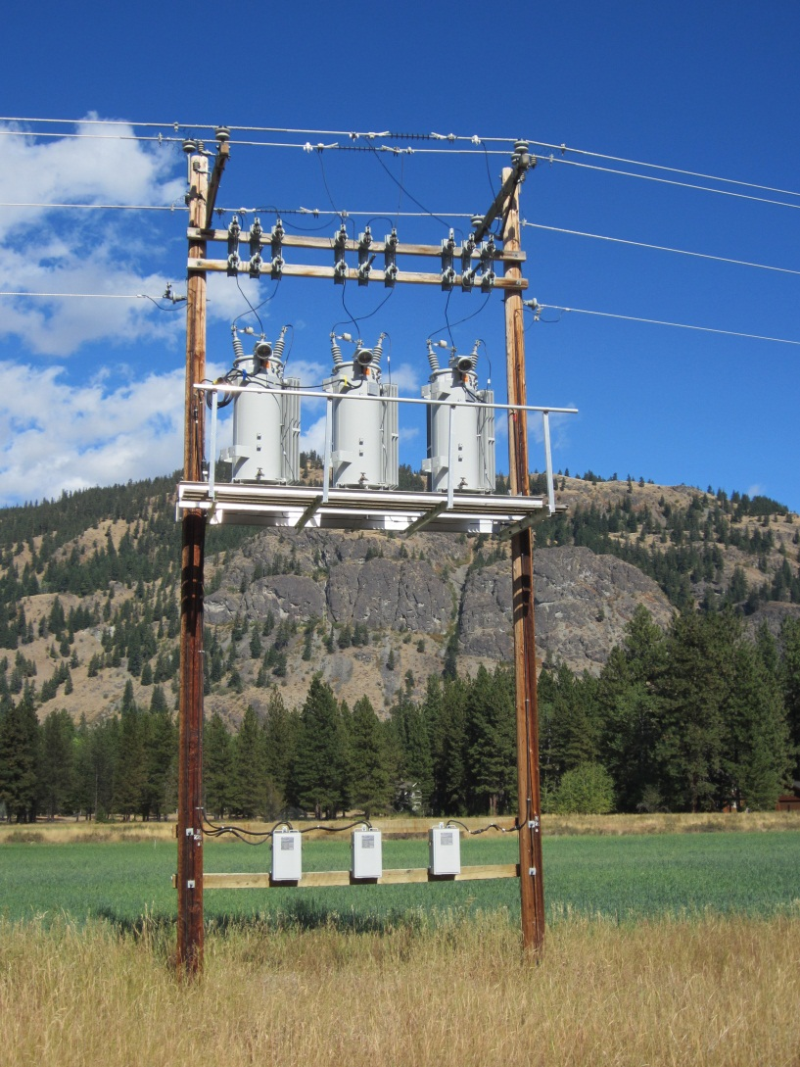
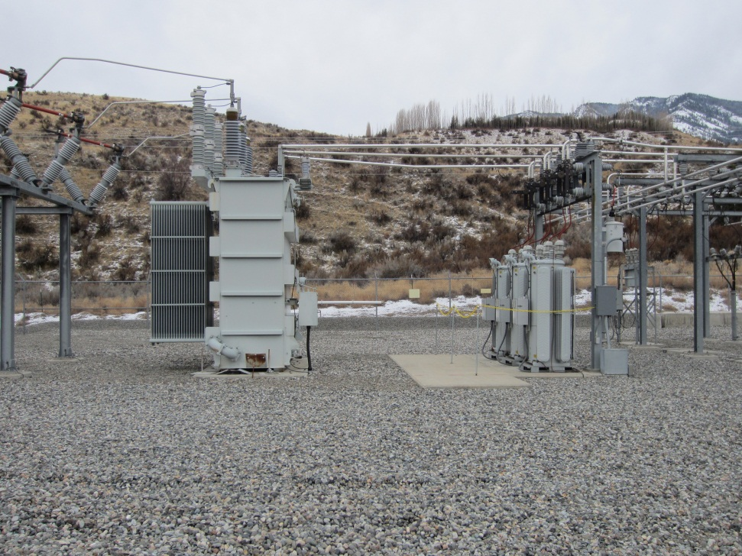
Part 2: Voltage Regulators

Slide 15
Multiple Tap Transformer
In a multiple tap transformer the output voltage can be adjusted by selecting different taps on the transformer.
Each tap gives a different turns ration, N₁:N₂.
All of the power flows across the air gap.

Slide 16
Autotransformers
An autotransformer is a single coil transformer, with part of the coil wrapped back on itself.
A single coil allows for a small voltage change, which is usually around 10%.
Autotransformers can be smaller because only a portion of the power flows across the air gap, the majority flows through copper.
These transformers provide no electrical isolation.

Slide 17
Autotransformers Cont.
Boost Configuration
Buck Configuration

Slide 18
Voltage Regulators
Voltage regulators are variable tap position devices, an autotransformer, that change the effective turns ratio of a single coil autotransformer.
In general, regulators have 33 tap positions that allow for a range of +/- 10% of nominal voltage.
16 taps “boost” voltage, 16 “buck” voltage, and a single tap gives a 1:1 turns ratio.

Slide 19
Voltage Regulators
16 taps “boost” voltage, 16 “buck” voltage, and a single tap gives a 1:1 turns ratio.
With +/- 16 taps over a 10% range each tap adjust voltage by 5/8 of a volt.

Slide 20
Control of Voltage Regulators
Fixed: Not all feeders have voltage regulators, in which case there is no active regulation.
Output voltage: the taps are adjusted to regulated the voltage on the output of the regulator.
Remote voltage: the taps are adjusted to regulated the voltage on a remote point on the feeder.
Line Drop Compensation (LDC): the taps are adjusted to regulate the voltage at a pseudo point in the system.

Slide 21
Fixed Voltage Control
For distribution feeders that are lightly loaded there may be no need to control voltage at the substation.
The voltage is determined by the transmission level voltage and the turns ratio of the substation transformer.
This is a low cost design but it lacks flexibility.

Slide 22
Output Voltage Control
If a voltage regulator is installed, regulating voltage at the output terminal of the regulators is the easiest.
The taps are adjusted to regulate the voltage at the output of the regulator.
With any active control system there must be appropriate operating bands to prevent excessive operation of the regulator, or oscillations. A “dead band” must be set for the regulator that is greater than the 5/8 volt/step for the regulator.

Slide 23
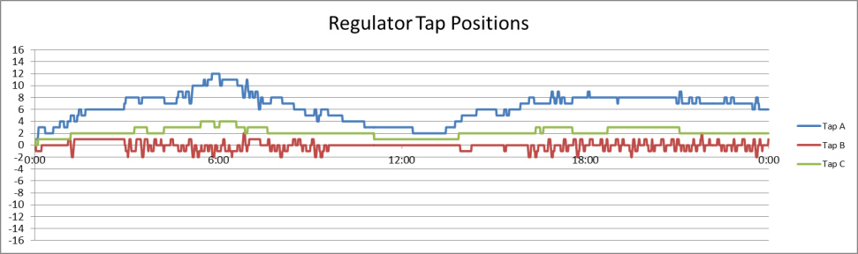
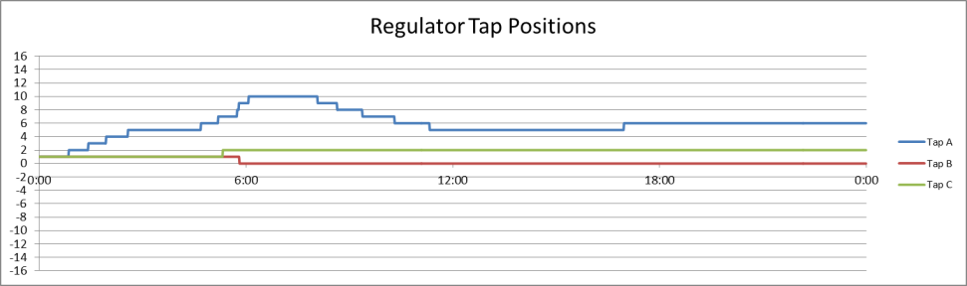
Control Dead Bands
Improper dead band
Proper dead band

Slide 24
Remote Voltage Control
If the voltage at the output of the regulator is not an adequate representation of the down stream voltage, it may be necessary to monitor a remote point.
This method is uncommon and only used in special situations.

Slide 25
Line Drop Compensation
LDC regulators use an internal model in order to regulate the voltage at an “estimated” down stream point.
Since this point is only estimated, and the system impedance changes with time, this is not the most accurate method.
This is a mid-cost option that is utilized by utilities.

Slide 26
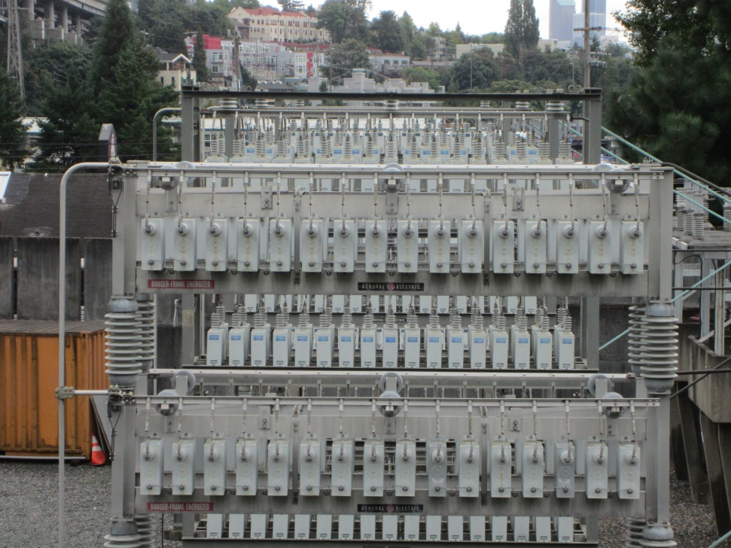
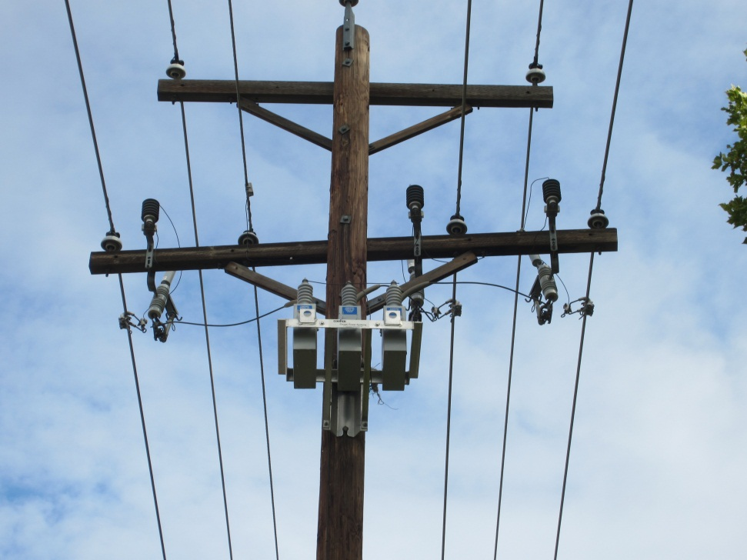
Part 3: Shunt Capacitors

Slide 27
Shunt Capacitors
Transmission: At this level capacitors are used to provide voltage support and to facilitate power transfers. Additionally, by utilizing capacitors, central generators are able to produce more real power.
Distribution Substation: Capacitors at the distribution system operate to provide local voltage support for the sub-transmission or transmission system.
Distribution Feeder: At the feeder level capacitors are used to provide voltage support which reduces line losses and allows the feeder to support higher load levels.

Slide 28
Control of Shunt Capacitors
Fixed: The capacitors are installed on a feeder and are continuously in operation. Generally the capacitors are connected through fuses.
Manual: A manually operated switch is used to place the capacitor in service and to remove it from service.
Voltage : The operation of the capacitor is based on a local voltage measurement.
VAR: The operation of the capacitor is based on the a local measurement of the reactive power flowing on the line leading to the capacitor.
Volt – VAR: The operation of the capacitor is based on the a local measurement of the reactive power flowing on the line leading to the capacitor, plus there is a local voltage measurement to prevent over voltage conditions.

Slide 29
Fixed Capacitor Controls
For some feeders the voltage drop is large enough at all times that installation of capacitors are used.
These capacitors are installed and are always in service.
When installed on a distribution feeder these are generally smaller capacitors, <600 kVAR.

Slide 30
Manual Capacitor Controls
When there is enough voltage variability in a system it may be necessary to install a manual switch on a capacitor.
Because of the need for a truck roll, these capacitors would generally be operated on a seasonal cycle.
These switches are locally operated.

Slide 31
Voltage Based Capacitor Controls
The operation of the capacitor is based on a local voltage measurement.
Voltage-based control is appropriate when there are large daily variations in the feeder load.
When the local voltage magnitude drops below a set point then the capacitor is switched into operation.
When the local voltage magnitude increases above a set point then the capacitor is switched out of operation.
Appropriate dead-bands must be established to prevent oscillations.

Slide 32
VAR Based Capacitor Controls
In a VAR-based control system the reactive power flowing into the line connecting the capacitor is the control variable, not voltage.
When the magnitude of reactive power increases above a set point, then the capacitor is switched into operation.
When the magnitude of reactive power drops below a set point, then the capacitor is switched out of operation.
Similar to voltage control, appropriate dead-bands must be established.

Slide 33
Volt-VAR Based Capacitor Controls
In Volt-VAR control the reactive power flowing on the input line is still the main control value, but there is a voltage override which will turn the capacitor off if the voltage is too high.
When the magnitude of reactive power increases above a set point, then the capacitor is switched into operation.
When the magnitude of reactive power drops below a set point, then the capacitor is switched out of operation.
If the local voltage exceeds a given level, the VAR control is overridden and the capacitor is switched out of operation.
Similar to voltage and VAR control, appropriate dead-bands must be established.

Slide 34

Part 4: Detailed End-use Load Models

Slide 35
Detailed End-use Load Models
Traditional transmission level powerflow analysis assumes that all loads are constant power, for both real (P) and reactive (Q). As a result, power and energy consumption are independent of line voltage.
This simplification was historically made for ease of analysis, but it is not appropriate at the distribution level.
At the distribution level it is necessary to utilize end-use load models that are voltage dependent.
Additionally, it is necessary to utilize load models that have time varying characteristics. The load on a distribution feeder varies significantly throughout the day.
The energy consumption of many end-use loads is dependent on factors other than voltage.

Slide 36
Detailed End-Use Load Models
There are 5 categories into which an end-use load model can be placed:
Time-invariant ZIP load models
Time-variant ZIP load models
Physical load models
Multi-state physical load models
Load profile models
The model type to be used is determined by the behavior of the end-use load, and the purpose of the study.
These load models can be used to represent a single end-use load or a combination of end-use loads.

Slide 37
Time-Invariant ZIP Load Model
The time-invariant ZIP load is the simplest voltage dependent load model. It is appropriate for a simple load with a operational single-state.
Each load is represented by a combination of three elements:
Constant impendence element (Z)
Constant current element (I)
Constant power element (P)
The time-invariant ZIP model may not be an accurate circuit model of the end-use load, but is an accurate representation of the voltage dependent power consumption.
All values are constant, and do not change with time.

Slide 38
ZIP Load Model Power Consumption
where:
P_{i} : real power consumption of the i^{th} load
Q_{i}: reactive power consumption of the i^{th} load
V_{a}: actual terminal voltage
V_{n}: nominal terminal voltage
S_{n}: apparent Power consumption at nominal voltage
Z%: percent of load that is constant impedance
I%: percent of load that is constant current
P%: percent of load that is constant power
Z_{θ}: phase angle of constant impedance component
I_{θ}: phase angle of constant current component
P_{θ}: phase angle of constant power component

Slide 39
ZIP Load Model Energy Consumption
In the time-invariant ZIP model all model parameters are constant, Z%, I%: P%, Z_{θ}, I_{θ}, and P_{θ}.
Only the actual voltage, V_{a}, changes.
As a result, the energy consumption only requires the integration of variations of the voltage.

Slide 40
Laboratory Determined Values for Example ZIP Loads
A selection of laboratory determined ZIP values will be examined for different end-use loads.
Lighting
Incandescent
Compact Fluorescent (CFL)
Light Emitting Diode (LED)
Televisions
Cathode Ray Tube (CRT)
Liquid Crystal Display (LCD)
These are values determined from one device, other models or manufactures will have different values.

Slide 41

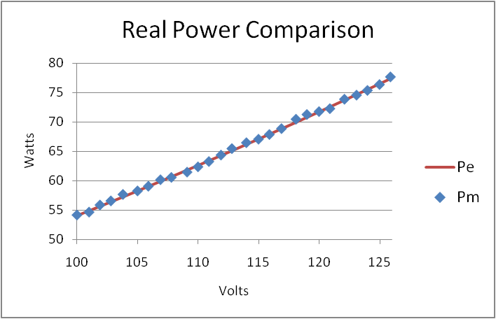
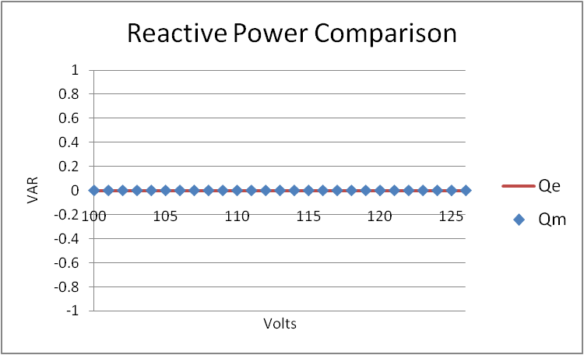
Incandescent Light Bulb

Slide 42
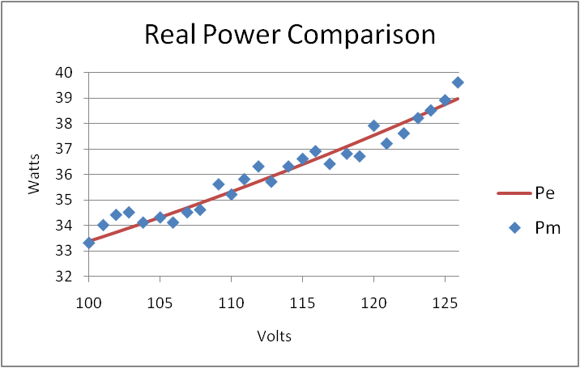
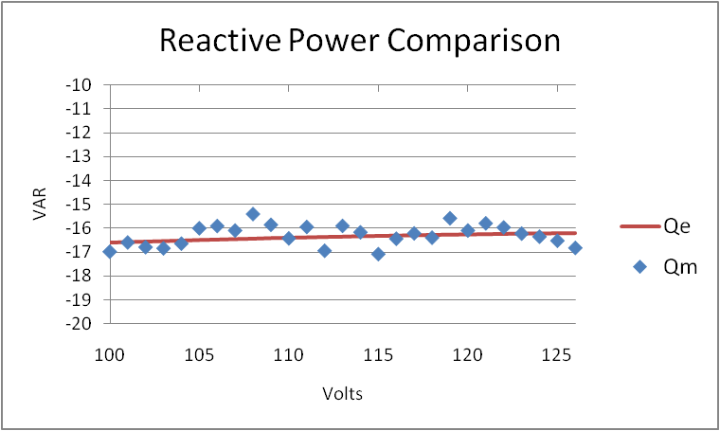
CFL Bulb

Slide 43
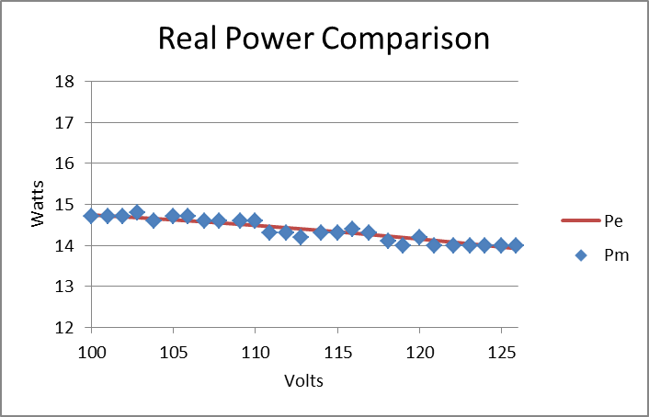
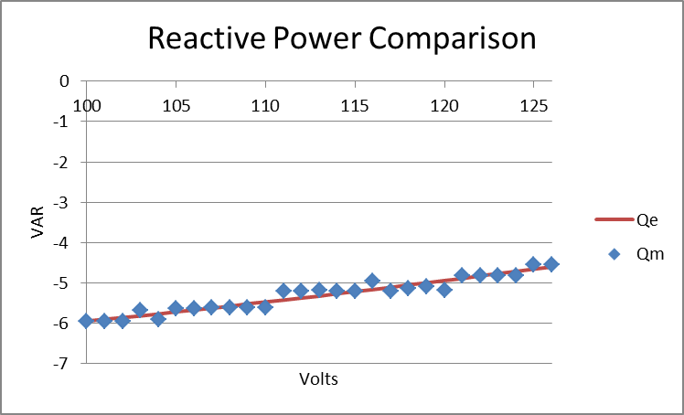
LED Bulb

Slide 44
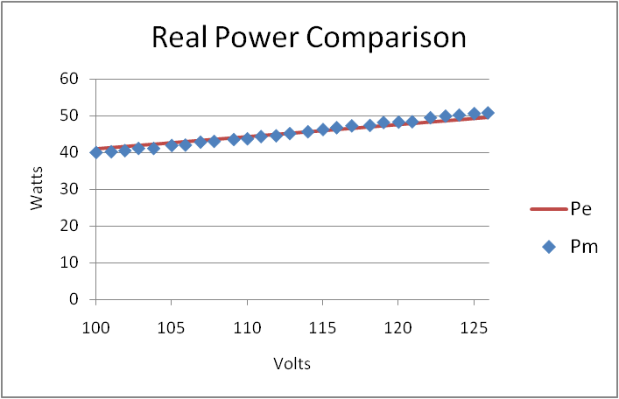
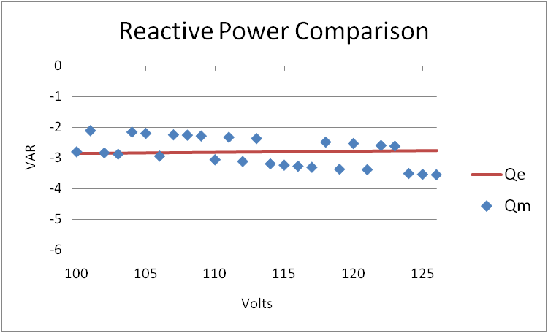
CRT

Slide 45
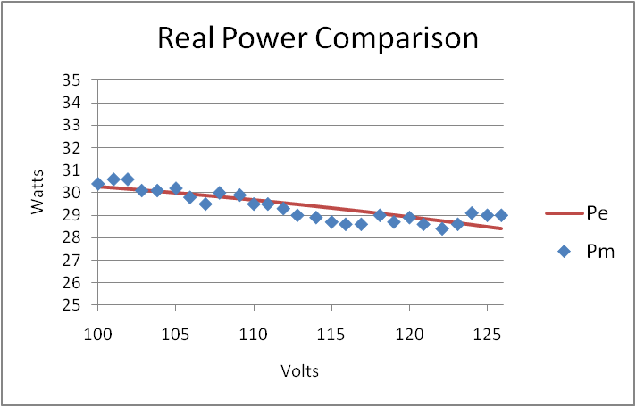
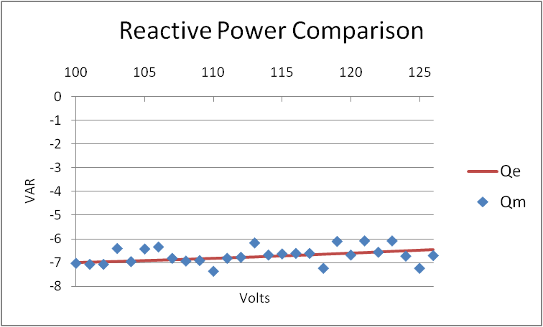
LCD

Slide 46
Determining the ZIP Values for Specific Load
If laboratory measurements are conducted on an end-use load, it is possible to convert these into the ZIP coefficients: Z%, I%: P%, Z_{θ}, I_{θ}, and P_{θ}.
The following process will show how to determine the ZIP coefficients from laboratory measurements.

Slide 47
Weighted Least Squares Fit
The Weighted Least Squares (WLS) fit is a method by which measured values are used to “fit” data to a given model.
In this case, we will use measurement data to determine the ZIP coefficients that give the best fit.
The measured values are: real and reactive power at different voltage levels.
The values to fit are: the ZIP coefficients, Z%, I%, P%, Z_{θ}, I_{θ}, and P_{θ,} in the ZIP model.
The WLS problems assumes a convex solution plane, it is less effective for problems with local minimum.

Slide 48
Weighted Least Squares Fit
There are measurements made at numerous points to ensure that the ZIP coefficients are an accurate representation at all voltages within the ANSI range.
A WLS differs from a least square fit in that each measurement can be independently weighed.

Slide 49
Weighted Least Squares Fit
It is assumed that in the laboratory measurements made at different voltages are equally accurate, therefore equally weighted.
As a result, the R matrix reduces to the Identity matrix and can be dropped.

Slide 50
Weighted Least Squares Fit cont.
Even though the R matrix will be an identity matrix for our purposes, it is left in this formulation for completeness.
x^{est} is the value of x which gives the lowest value of J(x).
These are the ZIP values which best fit the measured data.

Slide 51
Constrained Weighted Least Squares Fit
In a WLS fit it is possible to obtain estimated coefficients that while numerically accurate, are not the most appropriate representation.
For example, an angle of 32.5° is numerically identical to 4,352.5° when calculating a sine or cosine.
Additionally, the load must consume the correct amount of power at nominal voltage.
The following constraints are imposed on the WLS estimation.
Constraints

Slide 52
Time-Variant ZIP Load Model
In the previous examples the load utilized time-invariant ZIP models, but it is possible to implement a time-variant version.
In the time-zariant ZIP Load Model, the coefficients of the ZIP model can change with time: Z%, I%, P%, Z_{θ}, I_{θ}, and P_{θ}.
If the ZIP coefficients change, the power consumption at nominal voltage will change as well.
A time-variant ZIP model is best suited for an aggregated load model. Time-variant ZIP models can also be used with load shapes as will be discussed.

Slide 53
Physical Load Model
The ZIP model is an effective representations of end-use load when voltage is the only factor affecting power and energy consumption.
If there is a control loop governing the operation of the end-use load, then ZIP models are not appropriate.
Examples include:
Heating Ventilation and Air Conditioning
Hot water heating
Physical load models are based on a physical process and are time-variant in nature.
They can be significantly more complicated than ZIP models.
They provide the detail necessary to examine the actual behavior of end use loads.

Slide 54
Physical Load Model (Hot Water Heater)
When consuming electricity, the instantaneous power consumption of a hot water heater can be represented by a ZIP model that is 100% resistive. A power consumption of 4,500 W at nominal voltage is common.
The voltage dependent energy consumption of the water heater is given by:
At lower voltages less thermal energy is being contributed to the water mass, and at higher voltages more is contributed.
As a result, the amount of time the unit must consume electricity, i.e., time it is on, will vary based on the line voltage.
The change in time that the unit is on is reflected in the duty cycle.

Slide 55
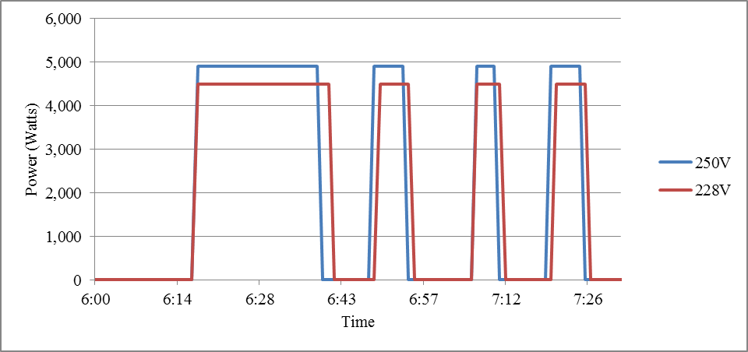
Physical Load Model (Hot Water Heater)
The plot below shows the energy consumption of a hot water heater at two voltage levels, 250V and 228V. (high and low level of ANSI C84.1)
When voltage is lowered, power consumption decreases, but the period of operation is increased. The same mass of water must be heated and the water heater thermostat changes the operation of the unit accordingly.
A simple ZIP model can capture changes in instantaneous power. But without knowing in advance how much the duty cycle changes, changes in energy consumption cannot be properly accounted for.

Slide 56
Multi-State Physical Load Models
A simple hot water heater only has a single state when consuming energy, “on”.
A more complex hot water heater model could have 2 states to represent the fact that hot water heaters often have two sets of heating elements, an upper and lower set.
State 1: Off
State 2: Single set of heating elements on
State 3: Both sets of heating elements on
Hot water heaters are resistive in nature regardless of the operational state. Other more complicated loads have significantly different behaviors in each operational state. HVAC systems are a good example of this:
State 1: Off
State 2: Cooling
State 3: Heating
State 4: Auxiliary Heating
In this example the HVAC system is assumed to be a heat pump.
The energy required for heating in State 4 will be much more than in State 3, despite the same thermal output.
Within each state a different load model can be implemented.

Slide 57
Physical Load Model (Residential HVAC System)
Similar to a hot water heater, a residential HVAC system is a thermally driven system.
A thermostat measures the internal air temperature, compares it to a user defined set point, and operate the HVAC system to maintain the temperature within a dead band.
The amount of energy an HVAC system consumes is a function of numerous variables:
Operational state
Outside air temperature
Incident solar energy
Desired internal air temperature
Construction of the building
Efficiency of the HVAC system
Amount of waste heat from internal building loads
The efficiency of the HVAC system will vary depending on the mode of operation.

Slide 58
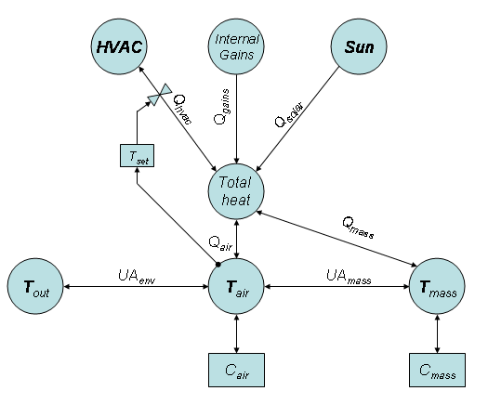
Physical Load Model (Residential HVAC System)
The Equivalent Thermal Parameter (ETP) Model is an accurate representation of the internal air temperature of a building.
It includes the coupling of the internal air temperature, T_{air}, to the external air temperature, T_{out}, through the building thermal envelope, UA_{env}.
The solution to the ETP model is obtained through the use of a set of coupled differential equations.
Based on the solution temperatures, the HVAC system will determine what mode to operate in.

Slide 59
Multi-State Physical Load Models
The ETP model only tracks the temperature of a building, it does not determine power consumption. Power consumption is determined by the HVAC operational state.
The operation of an HVAC system is determined by measured values, user defined set points, and internal set point.
User defined set points:
T_{high}: The temperature above which cooling turns on.
T_{low}: The temperature below which heating turns on.
Internal set points:
DB_{high}: The dead band around the T_{high} set point.
DB_{low}: The dead band around the T_{low} set point.
T_{aux}: The temperature below which the auxiliary heating elements turn on.

Slide 60
Multi-State Physical Load Models

Slide 61
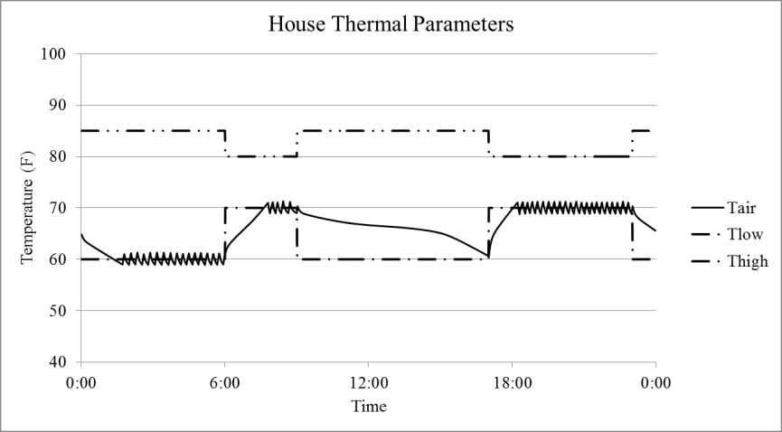
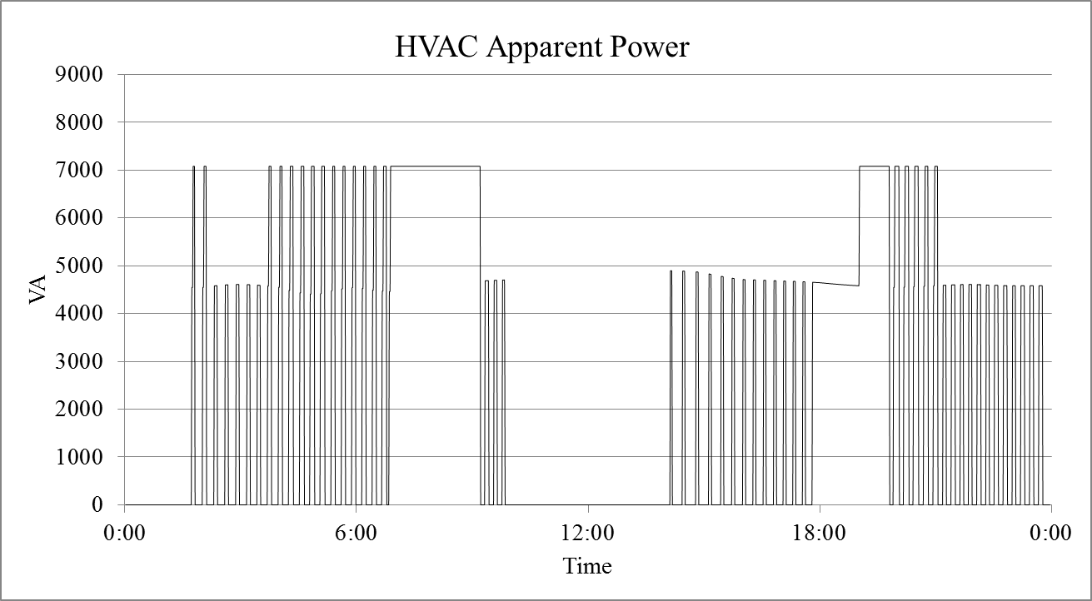
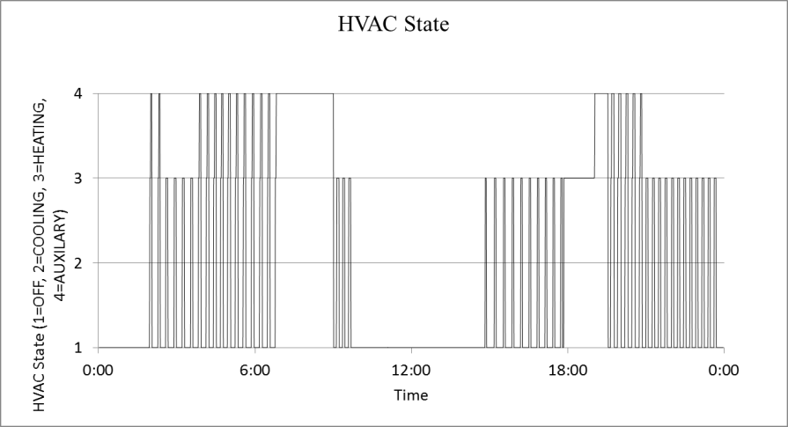
Physical Load Model – Residential HVAC

Slide 62
Load Profile Models
These are sometimes referred to as load profiles and have been used extensively for distribution analysis.
They can be fixed power values or time-variant ZIP models where ZIP coefficients change with time.
Often this information comes from measured data and is an aggregated value.
They are not able to capture complex load behaviors.

Slide 63
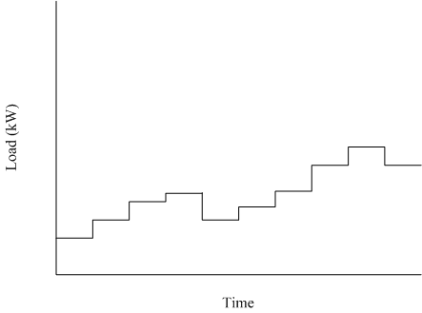
Example Load Profile

Slide 64
Coincidental Load Peaks
Distribution systems are operated based on the idea that not every customer will turn on all of their loads at a single time.
This concept is referred to as “load diversity”.
A 50 KVA service transformer may effectively serve 5 residential customers if there is load diversity.
The minimum service to a house is a 100 amp breaker panels. (100A*240V=24kVA)
It is not uncommon to have 200 amp or 250 amp breaker panels. (48kVA/60kVA)
Based on these numbers, the load connected to the transformer far exceeds the rating of the transformer.
If the 5 customers turned on all of the devices in a house, the transformer would be significantly overloaded.
Because of variations in human behavior load diversity is assumed.
Physical load models and multi-state load models can capture load diversity, time invariant ZIP model and load profiles cannot.
As a result, physical load models and multi-state load models are necessary when simulating technologies that impact load diversity.

Slide 65
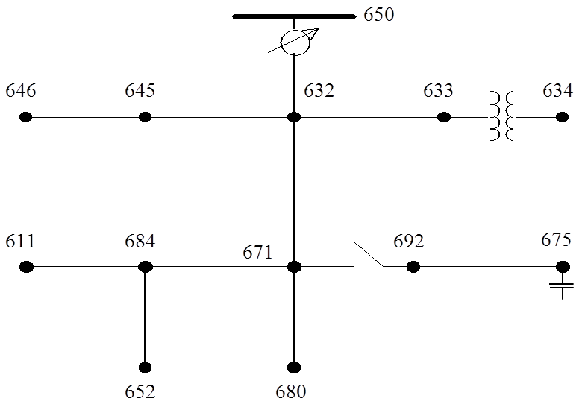
Voltage Control of the Modified IEEE 13 Node System
The model has been modified from the original test feeder in order to examine voltage control issues.
It is a 2,400V nominal system.
A voltage regulator is between node 650 and 632.
It operates to regulate the voltage at a remote node, node 671.
The normal dead band is +/- 30 V.
1 capacitor has been added at node 675.
It operates to maintain the voltage at node 675.
Voltage regulators and shunt capacitors can be used independently or together in a systems.

Slide 66
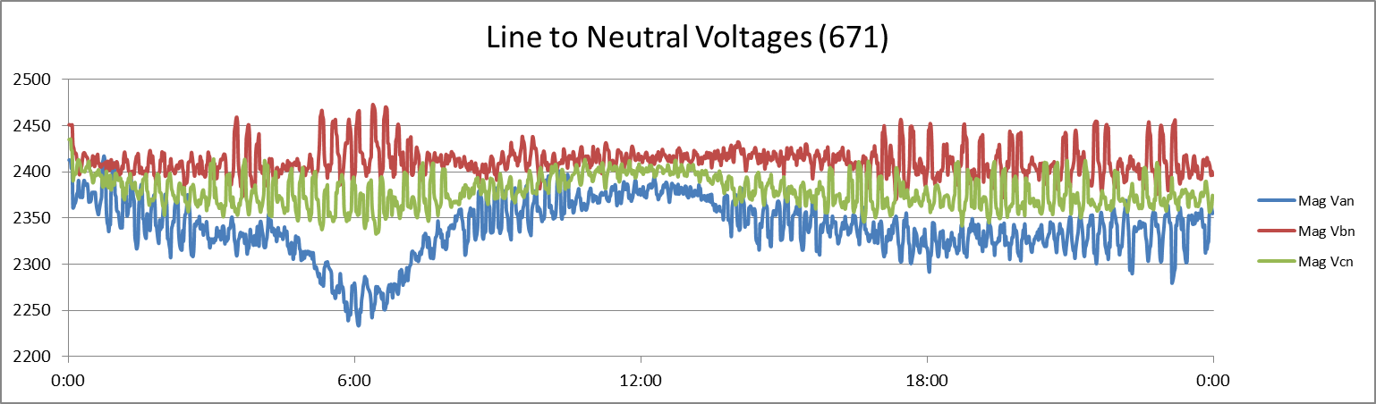
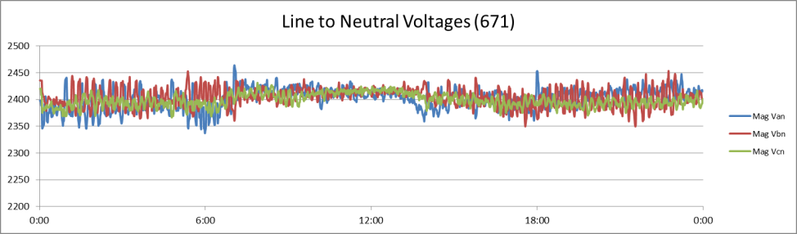
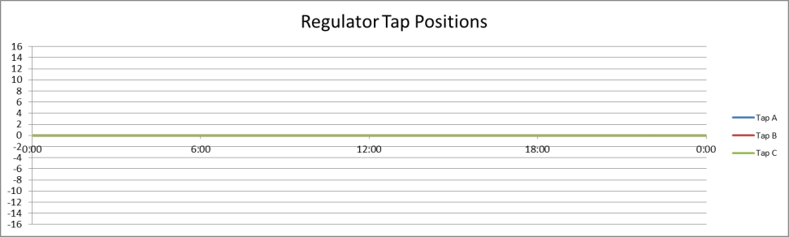
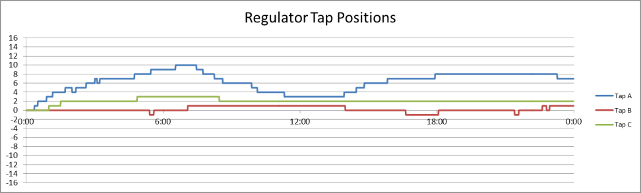
Voltage Control (Voltage Regulator)
No Regulator
With Regulator

Slide 67
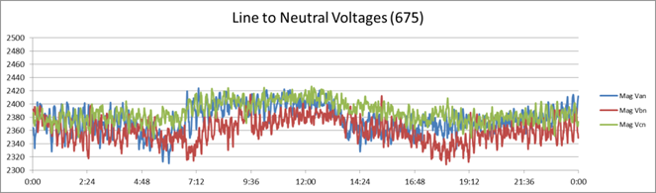
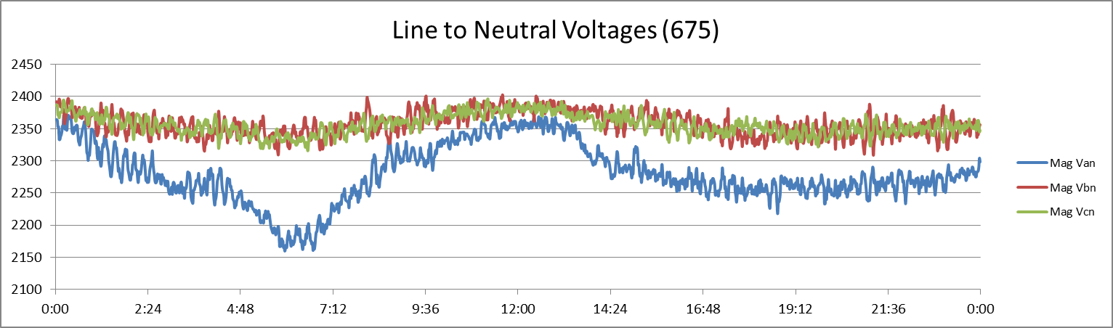
Voltage Control (Voltage Controlled Shunt Capacitors)
With the voltage regulator regulating the voltage at node 671, the voltage at 675 is also well regulated.
If the voltage regulator is removed from service then the voltage at node 675 is not well regulated.

Slide 68

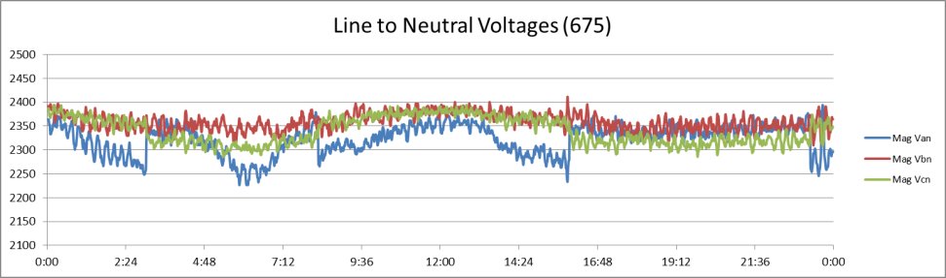
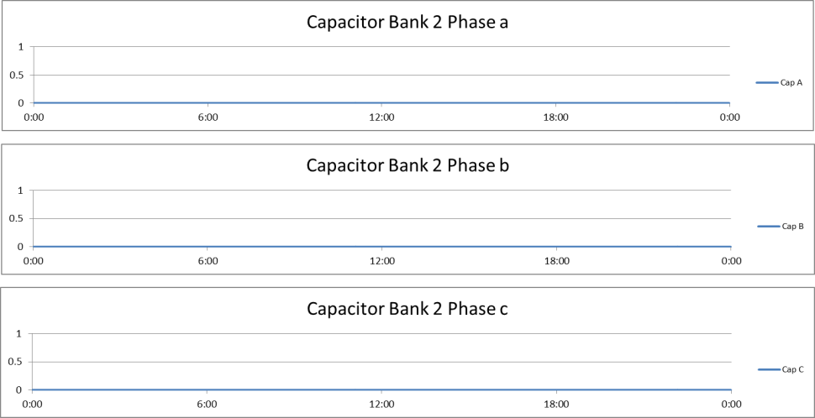
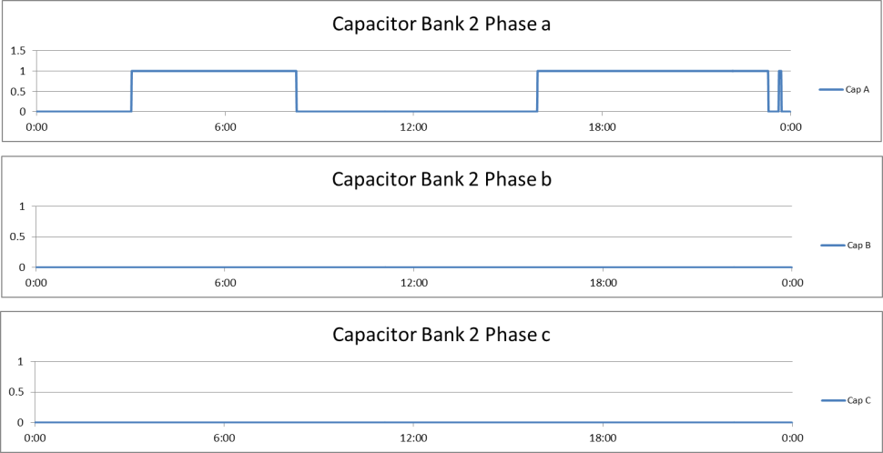
Voltage Control (Voltage Controlled Shunt Capacitors)
No Capacitor
With 600 KVAR Voltage Controlled Capacitor

Slide 69

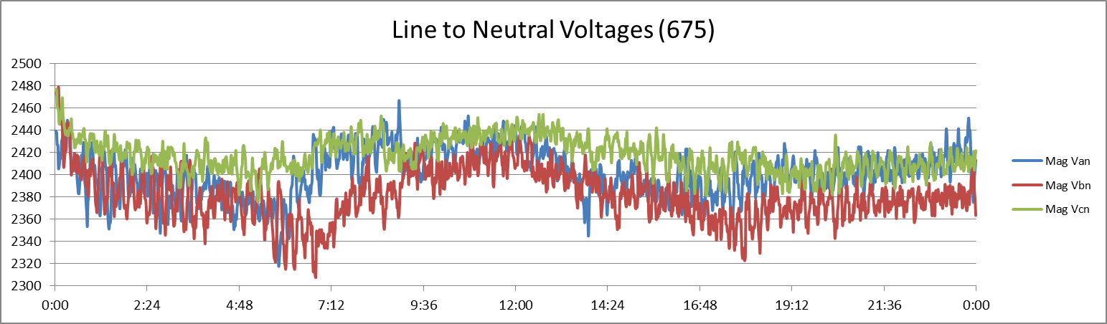
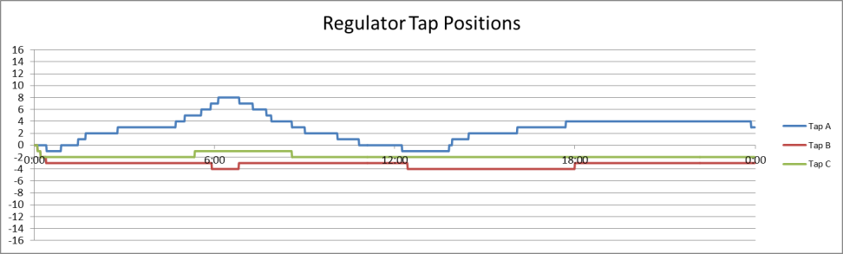
Voltage Control (Fixed Shunt Capacitor & Voltage Regulator)
No Capacitors
With 900 kVAR Fixed Capacitors
The reactive power contribution of the capacitors increases the average voltage.
With fixed capacitors, the percent voltage regulation is not significantly improved.
Because the fixed capacitors change the voltage profile of the system, they can impact the operation of the voltage regulator.

Slide 70
Module 4 Concluding Comments
Traditionally, voltage control has been achieved thorough the operation of devices operating only on local information.
Transmission: Voltage regulators at central generators and shunt capacitors
Distribution: Voltage regulators and shunt capacitors
Voltage control is essential to ensure the proper operation of the end-use loads.
Additionally, the energy consumption of end-use loads is a function of the supply voltage.
The voltage dependent nature of end-use loads can be modeled with a number of representations:
Time-invariant ZIP model
Time-variant ZIP model
Physical model
Multi-state physical model
Load profile

Slide 71
Substation and Distribution Automation
Conclusion of Module 4: Voltage Control Devices

